Slide 1
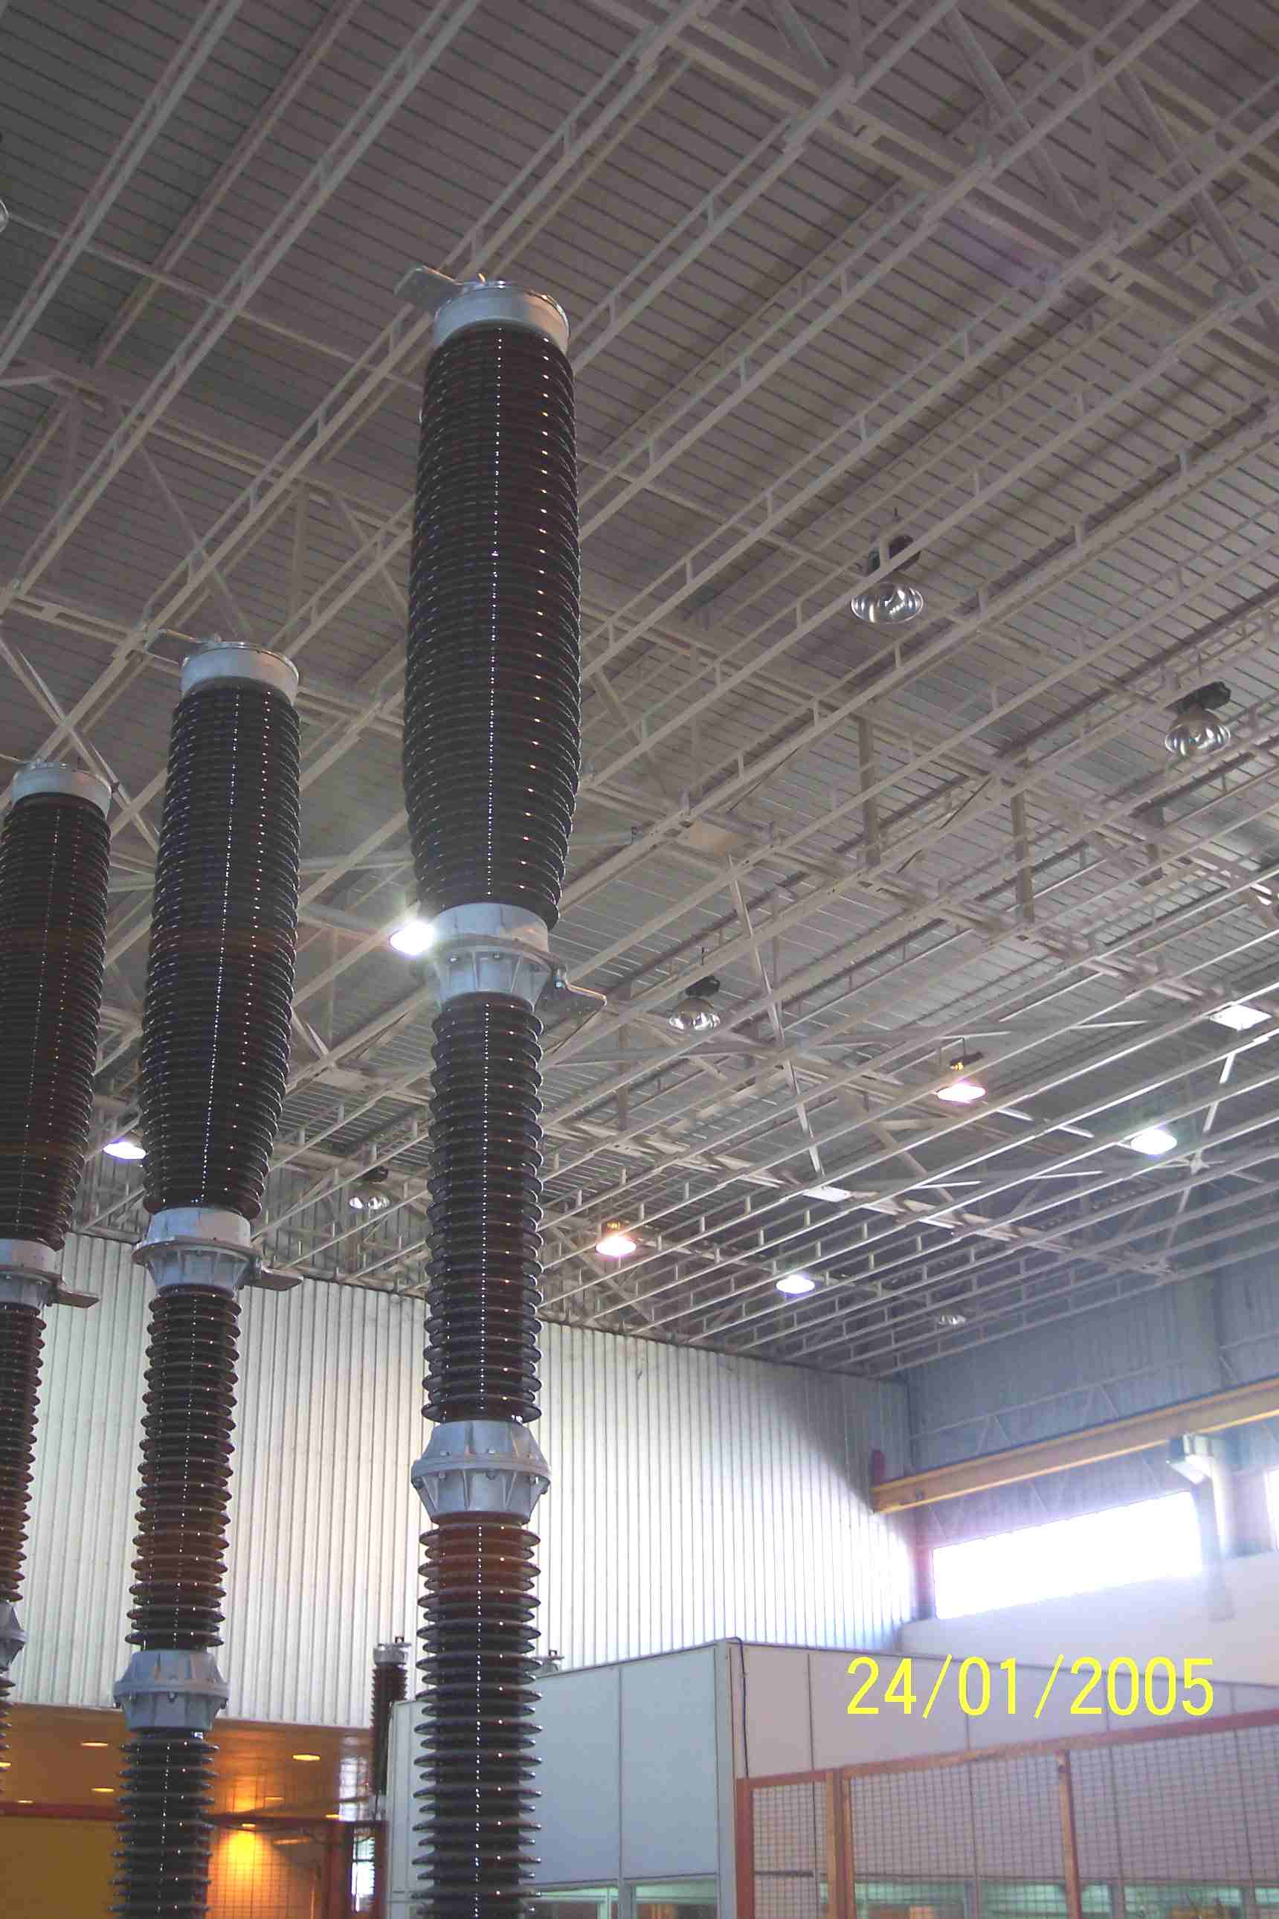
SIEMENS
HVCB SPARES
Support Insulator
245KV, 50KA CB
S4901880751 (2x per pole)

